Slide 1
HAMILTON MIDDLE SCHOOL Registration for 7th Grade
Mrs. Gravatt
6th Grade Counselor

Slide 2
AGENDA
1. Welcome and Introductions
2. Counseling Information
3. Academic Planning
4. 6th to 7th Grade Registration
a. Academic Courses
b. Electives
c. P.E./Athletics
d. Level One Courses
3. Gearing Up For The Future
a. Preparing for High School
b. High School Graduation Plan
4. Closure

Slide 3
COUNSELORS CAN HELP
Confidentiality and Safety
No harassment policy
If you are being harassed, tell an adult (teacher, counselor, assistant principal)
Crisis
A life threatening situation
Tell an adult immediately
Assistance with…
Academics (i.e. grades, tutoring, conferences, etc.)
Career exploration and future planning
Counselor’s Corner
Students can visit with the counselor on duty during all lunches
When necessary, students can request a pass to see their counselor
Provide information about programs, grade level opportunities, testing

Slide 4
Enjoy the Ride!
Family dinners
Family game night
Check those phones
Social media usage
Balance
College applications are more than GPA
Your children are only children once

Slide 5
TODAY WE ARE GOING TO TALK ABOUT…
Moving on to 7th Grade
Academic Planning

Slide 6
BEFORE WE GET STARTED…
Credit – a unit showing a student has successfully completed a high school course; each passing semester of a course earns 0.5 credits
GPA – Grade Point Average; cumulative; higher GPAs may result in more college & scholarship opportunities
Fine Arts – music, art or theater arts
Foreign Language – any language other than English
#lingotoknow

Slide 7
MOVING ON TO 7TH GRADE
Classes for Next Year

Slide 8
7TH GRADE SCHEDULE
Language Arts
Texas History
Science
Advisory
Math
P.E. or Athletics
Elective
Elective

Slide 9
K - LEVEL COURSES
Students currently in a K-Level course will be able to continue in the K-Level course as long as they maintain a 75+ average for the second semester.
Students interested in going into a K-Level course for the first time must have an 85+ yearly average in the previous on-level course.

Slide 10
K - LEVEL COURSES
Students can also become eligible for K-Level courses if they earn Masters Grade Level on their STAAR test for reading or math.
Moving up to K-Level math will require both summer school and an 85+ yearly average.

Slide 11
MATH SEQUENCE FOR STUDENTS IN L-LEVEL COURSES
Middle School
Grade 6 – On level Math
Grade 7 – On level Math
Grade 8 – Pre-Algebra
High School
Grade 9 – Algebra I
Grade 10 – Geometry
Grade 11 – Algebra II or Additional Math
Grade 12 – Pre-Calculus or Advanced Math

Slide 12
MATH SEQUENCE FOR STUDENTS IN K-LEVEL COURSES
Middle School
Grade 6 – Level 1 Math
Grade 7 – Pre-Algebra
Grade 8 – Algebra I
High School
Grade 9 – Geometry
Grade 10 – Algebra II
Grade 11 – Pre-Calculus
Grade 12 – Calculus or 5th Math

Slide 13
READING WORKSHOP AND MATH LAB
Reading Workshop and/or Math Lab will be required courses for some students based not meeting the grade level standard for STAAR tests. They will take the place of a regular elective.
This is why it’s important to do
your best! ☺

Slide 14
P.E./ATHLETICS
7th Grade students are required to take a full year of P.E. or athletics. You may take one full year of athletics if you are planning to play a sport.
Students may choose one of the following options:
One full year of P.E.
One full year of athletics (Available sports include cross country, football, basketball, volleyball and track.)
Off-Campus P.E.
(Off Campus P.E. applications are available at www.cfisd.net/page/1819
The application deadline is May 1st.
*You MUST have a doctor’s physical to participate in athletics

Slide 15
SEVENTH GRADE ELECTIVES
Full Year Courses
Band
Choir
Orchestra
Beginning Theatre Arts
Intermediate Theatre Arts
Principles of Applied Engineering**
Beginning Art
Advanced Art
Spanish I**
Mandarin I **
Spanish for Native Speakers I**
Principles of Human Services**
Yearbook (Has an Application)
**High School Credit Course

Slide 16
SEVENTH GRADE ELECTIVES
Semester Courses
Art Design
Exploring Foods and Fabrics
Touch System Data Entry: Keyboarding**
Coding and Robotics
**High School Credit Course

Slide 17
HIGH SCHOOL CREDIT COURSES OFFERED AT HAMILTON
Full Year Electives
Art I*
Spanish, or Chinese I & II* (may not have III in High School)
Spanish for Native Speakers I & II/III*
Principles of Applied Engineering
Principles of Manufacturing*
Principles of Architecture*
Principles of Human Services
Principles of Hospitality/Tourism*
Touch System Data Entry: Keyboarding
Principles of Information Technology*
*These classes are only offered to students in 8th grade

Slide 18
QUALIFYING CRITERIA
Beginning Theatre Arts
Full year course
Intermediate Theatre Arts
6th grade Th. Arts during the previous year
Theatre teacher recommendation or audition required
This is a full year competition course.
Advanced Art
6th grade Art, Art/Music rotation during 6th grade or prior portfolio approval by art teacher
Art teacher recommendation required
Full year course

Slide 19
FOREIGN LANGUAGE QUALIFICATIONS
Spanish I or Chinese I
Second semester average of 80+ in 6th grade on-level language arts or 75+ in K-level or HORIZONS language arts
Spanish for Native Speakers I
Spanish language background
Placement test
Chinese III may not be
Available in High School

Slide 20
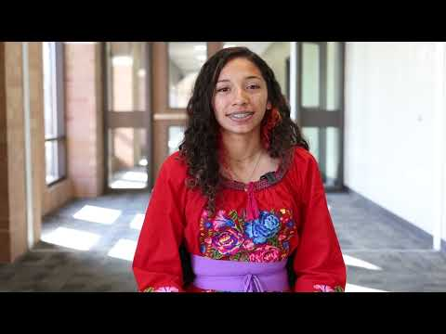
CFISD Spanish for Spanish Speakers

Slide 21
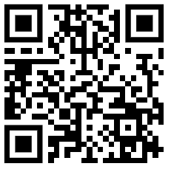
NATIVE SPEAKER SPANISH TESTING
IF Interested:
https://bit.ly/NSTestSignUp
Scan & sign up for testing!

Slide 22
OTHER QUALIFYING CRITERIA
Yearbook
Applications available in Counseling Office
Teacher recommendation
Full year elective
Can take 7th and 8th grade

Slide 23
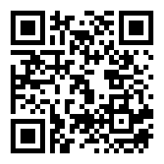
Registration is available online through a Google Link below. You will receive an email with the link and QR code. Mark your elective choices by selecting your first, second, third, and fourth choices in each section. Remember, you must have a total of 4 semesters of electives. 4 (½ year) courses or 2 full year courses
Registration Link
https://forms.gle/cVWP6iCHZU96a4v89

Slide 24
SOME THINGS TO THINK ABOUT…
If you choose a full-year elective, you are required to stay in that class ALL YEAR
If you sign up for full-year ATHLETICS, you MUST participate in a sport and remain in the class ALL YEAR
Choose wisely…absolutely NO changes will be made!

Slide 25
ACADEMIC PLANNING
Six Year High School Graduation Plan

Slide 26
GEARING UP FOR THE FUTURE
As a STUDENT, your job is to LEARN!
Registration is part of your academic planning.
Becoming familiar with current high school graduation requirements will help you choose classes for 7th grade.
You can take some high school credit classes in middle school.

Slide 27
LOOKING AHEAD TO HIGH SCHOOL…
You will need 22 credits plus 4 additional credits required for an endorsement to graduate from high school
You can earn some credits NOW in middle school

Slide 28
HIGH SCHOOL GRADUATION REQUIREMENTS
When you enter high school, you will graduate under the Foundation High School Program (FHSP) AND earn an endorsement.
An endorsement is like an area of study.
You must choose your endorsement during registration in 8th grade.
You will need to pass 5 STAAR end-of-course tests in high school.

Slide 29
THE ENDORSEMENTS
STEM (Science, Technology, Engineering & Math)
Business and Industry
Arts and Humanities
Public Services
Multidisciplinary Studies
There are many different options within each endorsement that you can choose from in order to complete the necessary requirements.

Slide 30
STEM
Careers in Science, Technology (including computer science), Engineering, & advanced Math

Slide 31
BUSINESS AND INDUSTRY
Careers in information technology, database management, marketing, accounting, finance, graphic design, construction, welding, automotive technology, agriculture, hospitality & tourism (Culinary Arts)

Slide 32
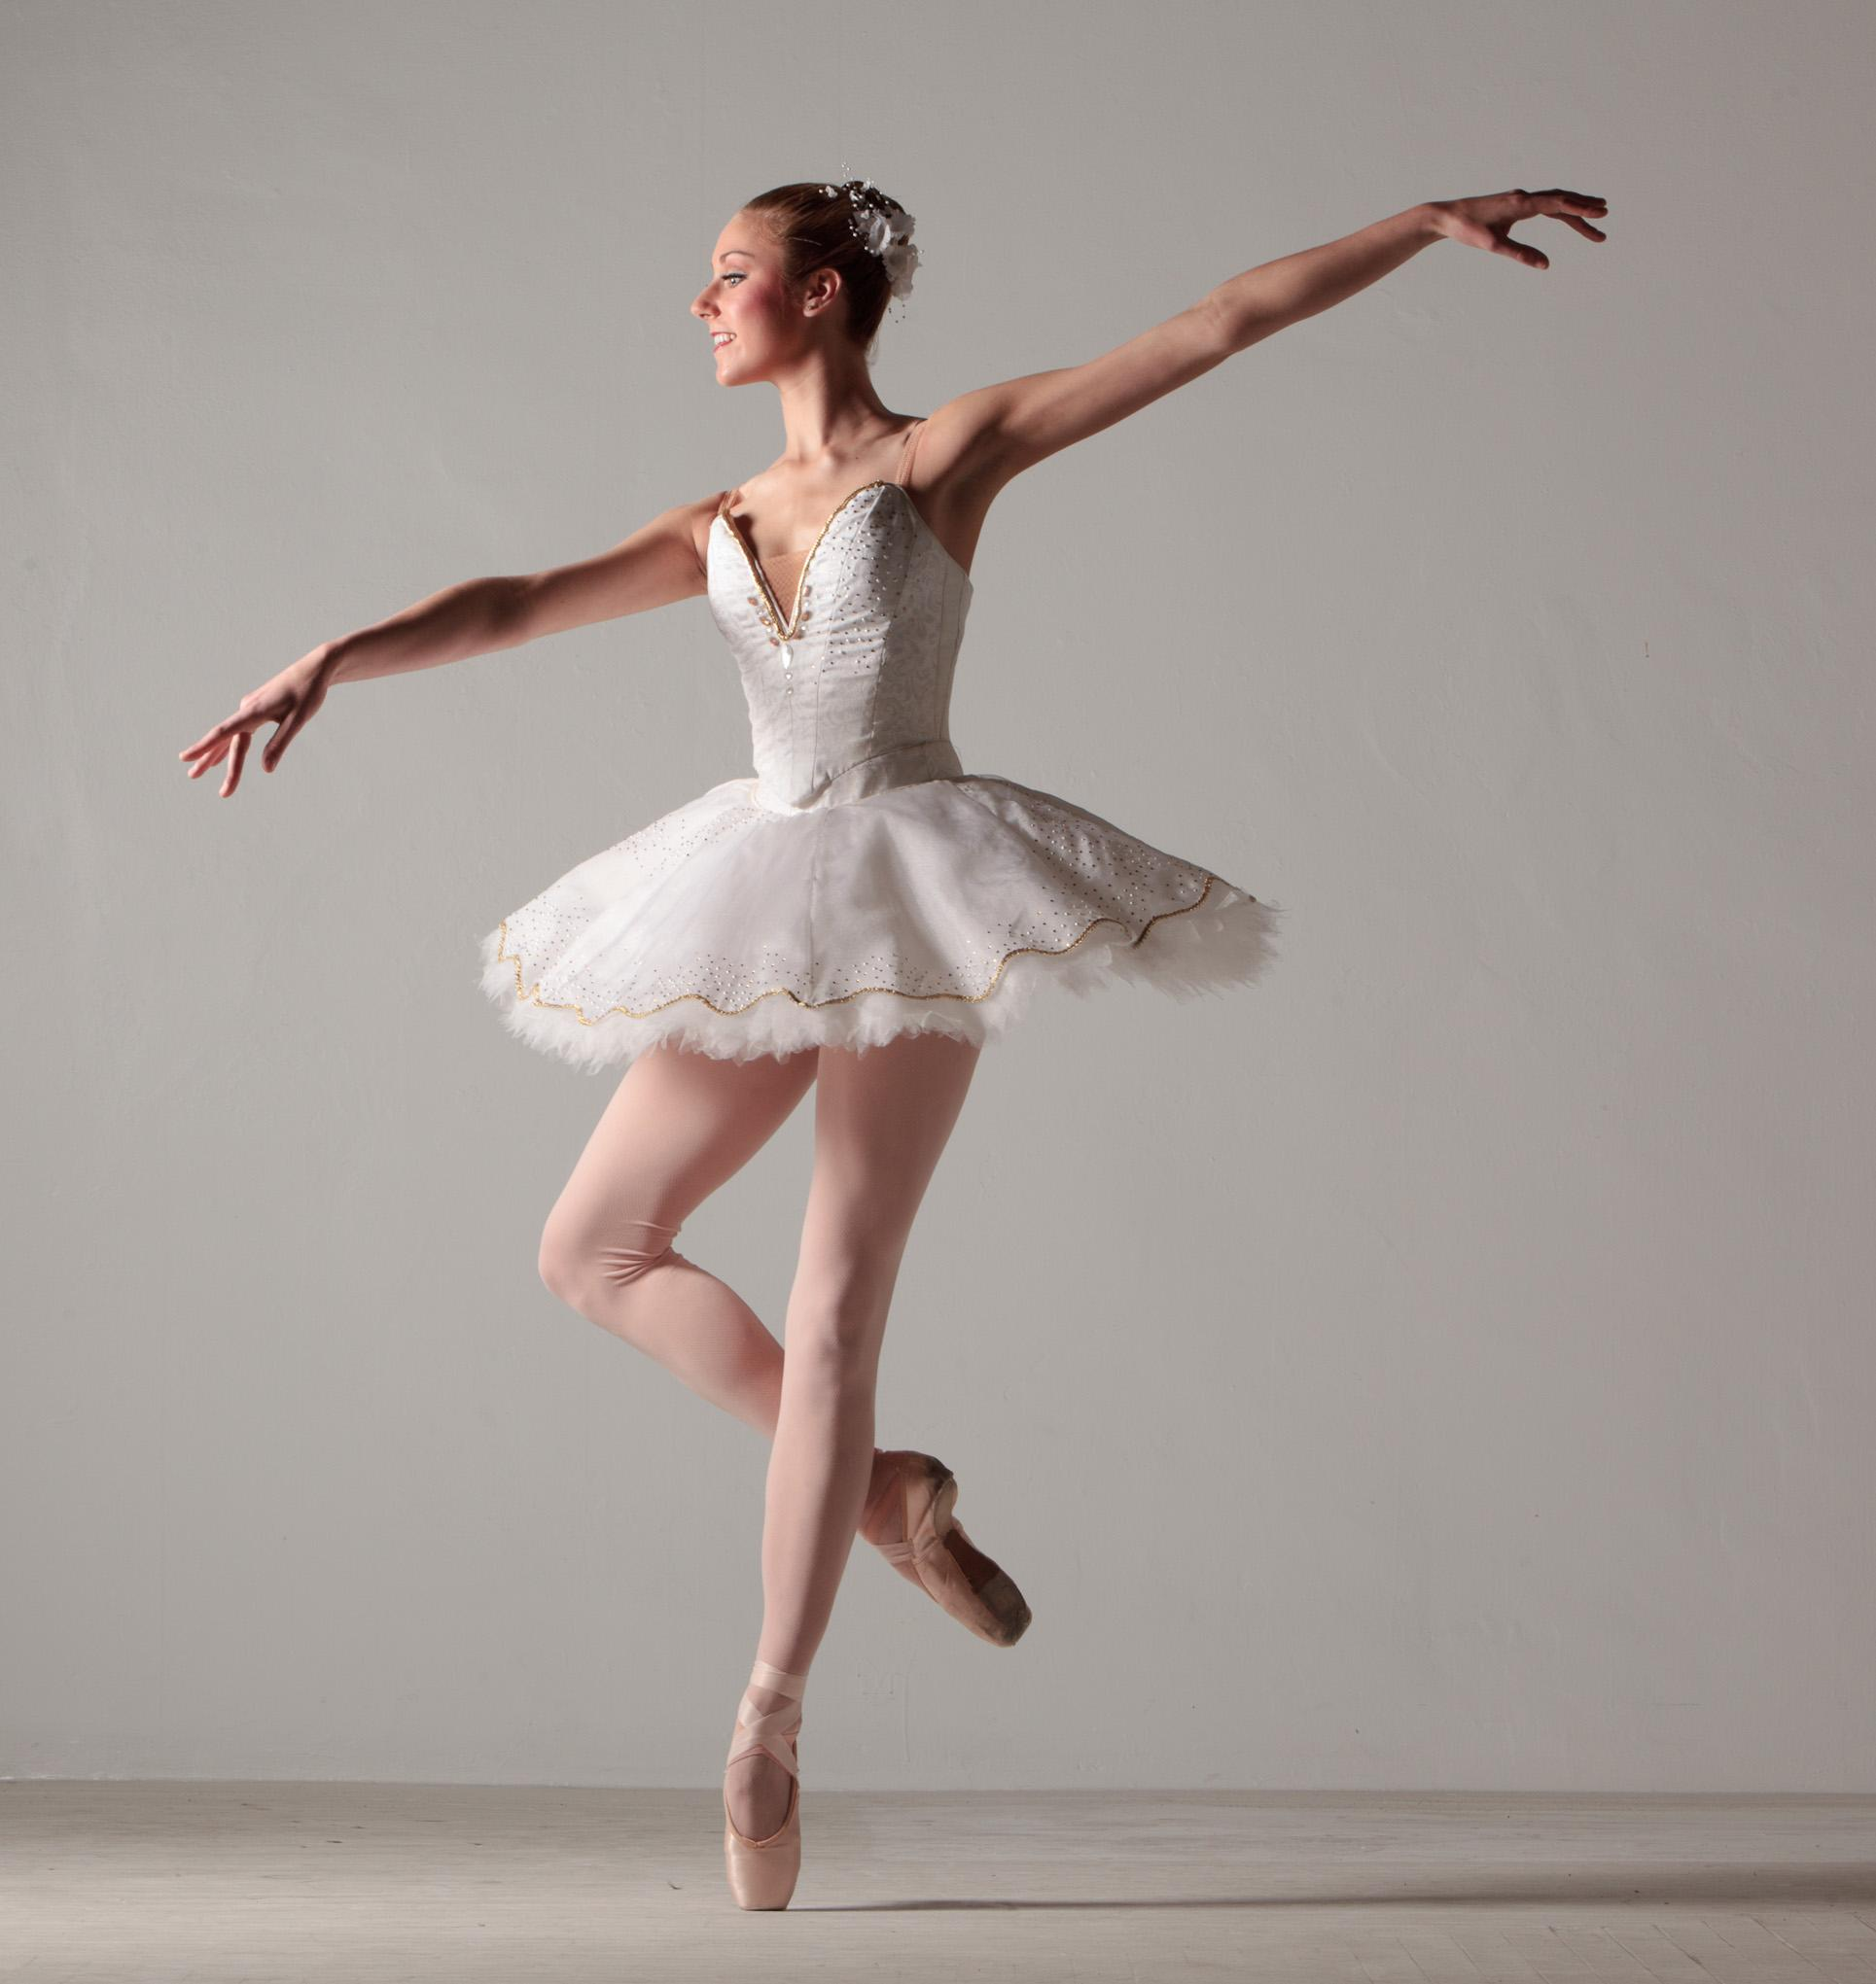
ARTS AND HUMANITIES
Political science, literature, world languages, cultural studies, history & fine arts

Slide 33
PUBLIC SERVICES
Careers in health science occupations, education, human services (child guidance, cosmetology), JROTC

Slide 34
MULTIDISCIPLINARY STUDIES
This endorsement provides students the opportunity to take a variety of courses from each of the other four endorsement areas.

Slide 35
Courses | Foundation | + Endorsement
English I–IV | 4
Math | 3 | +1 additional math course
Science | 3 | +1 additional science course
Social Studies | 3
PACE or PACE Plus | ½-1
P.E./Equivalent | 1
Health | ½
Foreign Language | 2
Fine Arts | 1
Electives | 4 | +2 additional electives
Total Credits | 22 | 26
*Some of these classes you may take in middle school

Slide 36
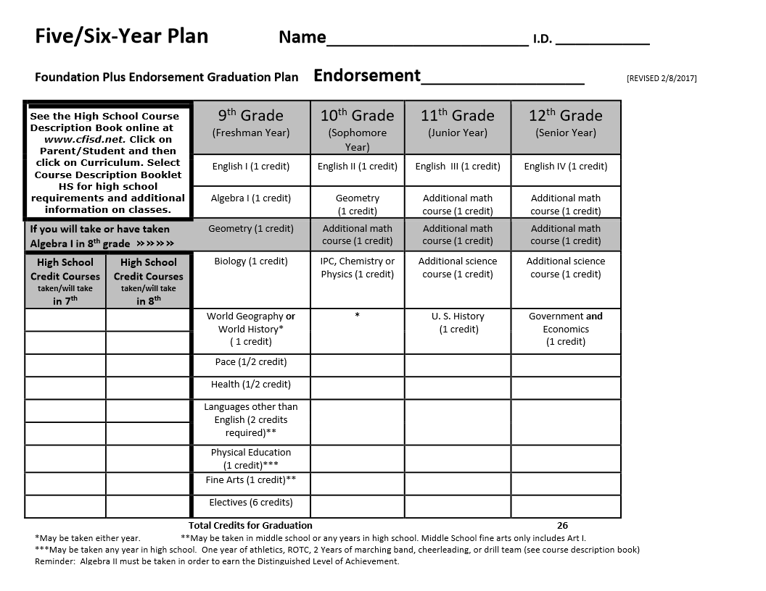
CREATING A SIX-YEAR PLAN
Foundation High School
Program Plus Endorsement
Required Courses
English 4
Math 3 + 1
Science 3 + 1
Social Studies 3
PACE .5
Health .5
Physical Ed. 1
Foreign Lang. 2
Fine Arts 1
Electives 4 + 2
TOTAL CREDITS 26

Slide 37
GRADUATION REQUIREMENTS
 |  | 9th Grade Freshman Year | 10th Grade Sophomore Year | 11th Grade Junior Year | 12th Grade Senior Year
 |  | English I (1 credit) | English II (1 credit) | English III (1 credit) | English IV (1 credit)
 |  | Algebra I | Geometry | 3rd Math (1 credit) | 4th Math (1 credit)
If you will take Algebra in 8th |  | Geometry (1 credit) | 3rd Math (1 credit) | 4thMath (1 credit) | 5thMath (1 credit)
 |  | Biology (1 credit) | IPC, Chemistry or Physics (1 credit) | 3rd Science (1 credit) | 4th Science (1 credit)
 |  | World Geography or World History (1 credit)* |  | U.S. History (1 credit) | U.S. Gov’t (.5 credit) Economics (.5 credit)
 |  | PACE (.5 credit)
 |  | Health (.5 credit)
 |  | Languages other than English (2 credits)**
 |  | Physical Education (1 credit)***
 |  | Fine Arts (1 credit)**
 |  | Electives (6 credits)
Foundation High School
Program Plus Endorsement
Required Courses
English 4
Math 3 + 1
Science 3 + 1
Social Studies 3
PACE .5
Health .5
Physical Ed. 1
Foreign Lang. 2
Fine Arts 1
Electives 4 + 2
TOTAL CREDITS 26

Slide 38
ENGLISH – 4 CREDITS
 |  | 9th Grade Freshman Year | 10th Grade Sophomore Year | 11th Grade Junior Year | 12th Grade Senior Year
 |  | English I (1 credit) | English II (1 credit) | English III (1 credit) | English IV (1 credit)
 |  | Algebra I | Geometry | 3rd Math (1 credit) | 4th Math (1 credit)
If you will take Algebra in 8th |  | Geometry (1 credit) | 3rd Math (1 credit) | 4thMath (1 credit) | 5thMath (1 credit)
 |  | Biology (1 credit) | IPC, Chemistry or Physics (1 credit) | 3rd Science (1 credit) | 4th Science (1 credit)
 |  | World Geography or World History (1 credit)* |  | U.S. History (1 credit) | U.S. Gov’t (.5 credit) Economics (.5 credit)
 |  | PACE (.5 credit)
 |  | Health (.5 credit)
 |  | Languages other than English (2 credits)**
 |  | Physical Education (1 credit)***
 |  | Fine Arts (1 credit)**
 |  | Electives (6 credits)
Foundation High School
Program Plus Endorsement
Required Courses
English 4
Math 3 + 1
Science 3 + 1
Social Studies 3
PACE .5
Health .5
Physical Ed. 1
Foreign Lang. 2
Fine Arts 1
Electives 4 + 2
TOTAL CREDITS 26

Slide 39
MATH – 4 CREDITS
 |  | 9th Grade Freshman Year | 10th Grade Sophomore Year | 11th Grade Junior Year | 12th Grade Senior Year
 |  | English I (1 credit) | English II (1 credit) | English III (1 credit) | English IV (1 credit)
 |  | Algebra I | Geometry | 3rd Math (1 credit) | 4th Math (1 credit)
If you will take Algebra in 8th |  | Geometry (1 credit) | 3rd Math (1 credit) | 4thMath (1 credit) | 5thMath (1 credit)
 |  | Biology (1 credit) | IPC, Chemistry or Physics (1 credit) | 3rd Science (1 credit) | 4th Science (1 credit)
 |  | World Geography or World History (1 credit)* |  | U.S. History (1 credit) | U.S. Gov’t (.5 credit) Economics (.5 credit)
 |  | PACE (.5 credit)
 |  | Health (.5 credit)
 |  | Languages other than English (2 credits)**
 |  | Physical Education (1 credit)***
 |  | Fine Arts (1 credit)**
 |  | Electives (6 credits)
Foundation High School
Program Plus Endorsement
Required Courses
English 4
Math 3 + 1
Science 3 + 1
Social Studies 3
PACE .5
Health .5
Physical Ed. 1
Foreign Lang. 2
Fine Arts 1
Electives 4 + 2
TOTAL CREDITS 26

Slide 40
SCIENCE – 4 CREDITS
 |  | 9th Grade Freshman Year | 10th Grade Sophomore Year | 11th Grade Junior Year | 12th Grade Senior Year
 |  | English I (1 credit) | English II (1 credit) | English III (1 credit) | English IV (1 credit)
 |  | Algebra I | Geometry | 3rd Math (1 credit) | 4th Math (1 credit)
If you will take Algebra in 8th |  | Geometry (1 credit) | 3rd Math (1 credit) | 4thMath (1 credit) | 5thMath (1 credit)
 |  | Biology (1 credit) | IPC, Chemistry or Physics (1 credit) | 3rd Science (1 credit) | 4th Science (1 credit)
 |  | World Geography or World History (1 credit)* |  | U.S. History (1 credit) | U.S. Gov’t (.5 credit) Economics (.5 credit)
 |  | PACE (.5 credit)
 |  | Health (.5 credit)
 |  | Languages other than English (2 credits)**
 |  | Physical Education (1 credit)***
 |  | Fine Arts (1 credit)**
 |  | Electives (6 credits)
Foundation High School
Program Plus Endorsement
Required Courses
English 4
Math 3 + 1
Science 3 + 1
Social Studies 3
PACE .5
Health .5
Physical Ed. 1
Foreign Lang. 2
Fine Arts 1
Electives 4 + 2
TOTAL CREDITS 26

Slide 41
SOCIAL STUDIES – 3 CREDITS
 |  | 9th Grade Freshman Year | 10th Grade Sophomore Year | 11th Grade Junior Year | 12th Grade Senior Year
 |  | English I (1 credit) | English II (1 credit) | English III (1 credit) | English IV (1 credit)
 |  | Algebra I | Geometry | 3rd Math (1 credit) | 4th Math (1 credit)
If you will take Algebra in 8th |  | Geometry (1 credit) | 3rd Math (1 credit) | 4thMath (1 credit) | 5thMath (1 credit)
 |  | Biology (1 credit) | IPC, Chemistry or Physics (1 credit) | 3rd Science (1 credit) | 4th Science (1 credit)
 |  | World Geography or World History (1 credit)* |  | U.S. History (1 credit) | U.S. Gov’t (.5 credit) Economics (.5 credit)
 |  | PACE (.5 credit)
 |  | Health (.5 credit)
 |  | Languages other than English (2 credits)**
 |  | Physical Education (1 credit)***
 |  | Fine Arts (1 credit)**
 |  | Electives (6 credits)
Foundation High School
Program Plus Endorsement
Required Courses
English 4
Math 3 + 1
Science 3 + 1
Social Studies 3
PACE .5
Health .5
Physical Ed. 1
Foreign Lang. 2
Fine Arts 1
Electives 4 + 2
TOTAL CREDITS 26
*May be taken either in 9th or 10th grade.

Slide 42
OTHER REQUIRED COURSES
 |  | 9th Grade Freshman Year | 10th Grade Sophomore Year | 11th Grade Junior Year | 12th Grade Senior Year
 |  | English I (1 credit) | English II (1 credit) | English III (1 credit) | English IV (1 credit)
 |  | Algebra I | Geometry | 3rd Math (1 credit) | 4th Math (1 credit)
If you will take Algebra in 8th |  | Geometry (1 credit) | 3rd Math (1 credit) | 4thMath (1 credit) | 5thMath (1 credit)
 |  | Biology (1 credit) | IPC, Chemistry or Physics (1 credit) | 3rd Science (1 credit) | 4th Science (1 credit)
 |  | World Geography or World History (1 credit)* |  | U.S. History (1 credit) | U.S. Gov’t (.5 credit) Economics (.5 credit)
 |  | PACE (.5 credit)
 |  | Health (.5 credit)
 |  | Languages other than English (2 credits)**
 |  | Physical Education (1 credit)***
 |  | Fine Arts (1 credit)**
 |  | Electives (6 credits)
Foundation High School
Program Plus Endorsement
Required Courses
English 4
Math 3 + 1
Science 3 + 1
Social Studies 3
PACE .5
Health .5
Physical Ed. 1
Foreign Lang. 2
Fine Arts 1
Electives 4 + 2
TOTAL CREDITS 26
*May be taken either in 9th or 10th grade.

Slide 43
INTERESTED IN TAKING HIGH SCHOOL COURSES IN MIDDLE SCHOOL?
Information on classes you can take in Summer School will not be available until the beginning of April
Summer School is $210 per session.

Slide 44
LOOKING AHEAD: COLLEGE ACADEMY
Available at all CFISD High Schools
College Academy is a partnership between CFISD & Lone Star
Eligible student may earn a HS diploma AND an Associate Degree within grades 9-12

Slide 45
COLLEGE ACADEMY
Students apply during the spring of 8th grade.
Eligibility requirements include
80+ average in Algebra I
80+ average in K-Level/Horizons Language Arts
For more info see CFISD.net
Academics
College-Career-Readiness
College Academy

Slide 46
REMEMBER…THIS IS JUST A PLAN!
I hope this framework can help you plan for your future. You can do anything you set your mind to!
Best wishes,
Mrs. Gravatt

Slide 47
NO SCHEDULE CHANGES……
Elective
Change
Schedules will not be changed after the last day of school.
You are married for 1 year to your elective/PE choices!
No Divorces = No elective changes
DEADLINE: April 30, 2024

Slide 48
WOW…TIME FLIES! YOU’RE ALMOST A 7TH GRADER!
*Complete the Online Registration form by March 8th
*Form link will be emailed through School Messenger

Slide 49
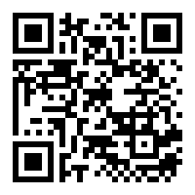
Questions?
Counselors are available to answer simple questions, but please use the QR code below for complex questions

